Slide 1
TNSDC-Generative AI
Stock Analysis(Google,Microsoft,Apple,
Amazon,Tesla)Using LSTM
Presented by :Maheshwaran. N,
au211521104084,
Pre-Final Student,
Computer Science and Engineering,
Panimalar Institute of Technology.

Slide 2

OUTLINE
Problem Statement
Proposed Solution
System Approach
Algorithm
Result
Conclusion
References

Slide 3
PROBLEM STATEMENT
In today's dynamic financial markets, investors and traders are constantly seeking tools and strategies to make informed decisions about buying, selling, or holding stocks. Stock price analysis plays a pivotal role in this decision-making process by providing insights into past performance, current trends, and potential future movements of stock prices. The challenge lies in accurately predicting these movements amidst the complex interplay of various factors such as market sentiment, economic indicators, company performance, and geopolitical events.

Slide 4
PROPOSED SOLUTION
The proposed system aims to develop an intelligent stock price analysis platform that leverages advanced technologies such as machine learning, natural language processing, and big data analytics to provide actionable insights to investors, traders, and financial analysts. The system will collect, process, and analyze vast amounts of historical and real-time financial data to predict stock price movements, identify trends, and assess market sentiment. By combining quantitative models with qualitative analysis, the system will offer a comprehensive approach to stock price analysis, enabling users to make informed investment decisions in dynamic market conditions.
Data Collection and Integration:
Gather diverse sources of financial data, including historical stock prices, company financial reports, news articles, social media feeds, and macroeconomic indicators.
Integrate structured and unstructured data using data pipelines and APIs to create a unified dataset for analysis.

Slide 5
SYSTEM APPROACH
Hardware:
CPU: The system requires a CPU with sufficient processing power to handle the computational demands of Convolutional Neural Network (CNN) training and inference. A multi-core processor, preferably with a clock speed of at least 2 GHz or higher, is recommended.
Memory: A minimum of 8 GB RAM is recommended for smooth operation, especially during model training, where large datasets are processed. More RAM may be required for handling larger datasets or concurrent user requests.
Internet Speed: A stable internet connection is necessary for downloading and updating Python packages, model weights, and serving the web application. A broadband connection with a minimum download speed of 5 Mbps and upload speed of 1 Mbps is sufficient for most purposes.

Slide 6
SYSTEM APPROACH – CONT.
Software:
Python: The system is built using Python programming language
PyTorch: PyTorch, a machine learning library, is utilized for implementing the Convolutional Neural Network (CNN) architecture. PyTorch provides efficient tensor computation with GPU acceleration, facilitating faster model training and inference.
Python-facepp – To install this module type the below command in the terminal. Pip install python-facepp emoji – To install this module type the below command in the terminal. Pip install emoji.
This app compares two photographs of the same person or two different persons against his/her face features like face landmarks, beauty score, face emotion, etc. If both photographs are matching with each other, the app result is “Both photographs are of same person ” otherwise app result is “Both photographs are of two different persons”.

Slide 7

ALGORITHM
One common algorithm for stock price analysis is the Autoregressive Integrated Moving Average (ARIMA) model. ARIMA is a popular time series forecasting method that is widely used in finance for predicting future stock prices based on historical data. Here's an overview of the ARIMA algorithm:
1.Data Preprocessing:
Collect historical stock price data, typically daily or hourly prices, along with any relevant features such as trading volume.
Check for missing values and outliers in the data and handle them appropriately (e.g., interpolation, removal).
2. Model Identification:
Determine the appropriate order of differencing (d), autoregressive (p), and moving average (q) terms for the ARIMA model.
Use techniques such as autocorrelation function (ACF) and partial autocorrelation function (PACF) plots to identify potential values for p and q.Conduct unit root tests such as the Augmented Dickey-Fuller (ADF) test to determine the order of differencing (d) required to achieve stationarity.

Slide 8
ALGORITHM - CONT.
3.Model Estimation:
Fit the ARIMA model to the pre processed data using the identified values for p, d, and q.
Estimate the model parameters using maximum likelihood estimation or other optimization techniques.
Validate the model fit using diagnostic tests such as residual analysis to ensure that the model adequately captures the underlying patterns in the data.
4.Model Forecasting:
Use the fitted ARIMA model to generate forecasts of future stock prices.
Forecast multiple time steps ahead to capture longer-term trends and patterns in the data.
Calculate prediction intervals to quantify the uncertainty associated with the forecasts.
5. Model Evaluation:
Evaluate the accuracy of the ARIMA forecasts using appropriate performance metrics such as Mean Absolute Error (MAE), Mean Squared Error (MSE), or Root Mean Squared Error (RMSE).Compare the forecasted values to the actual stock prices to assess the model's predictive power.

Slide 9
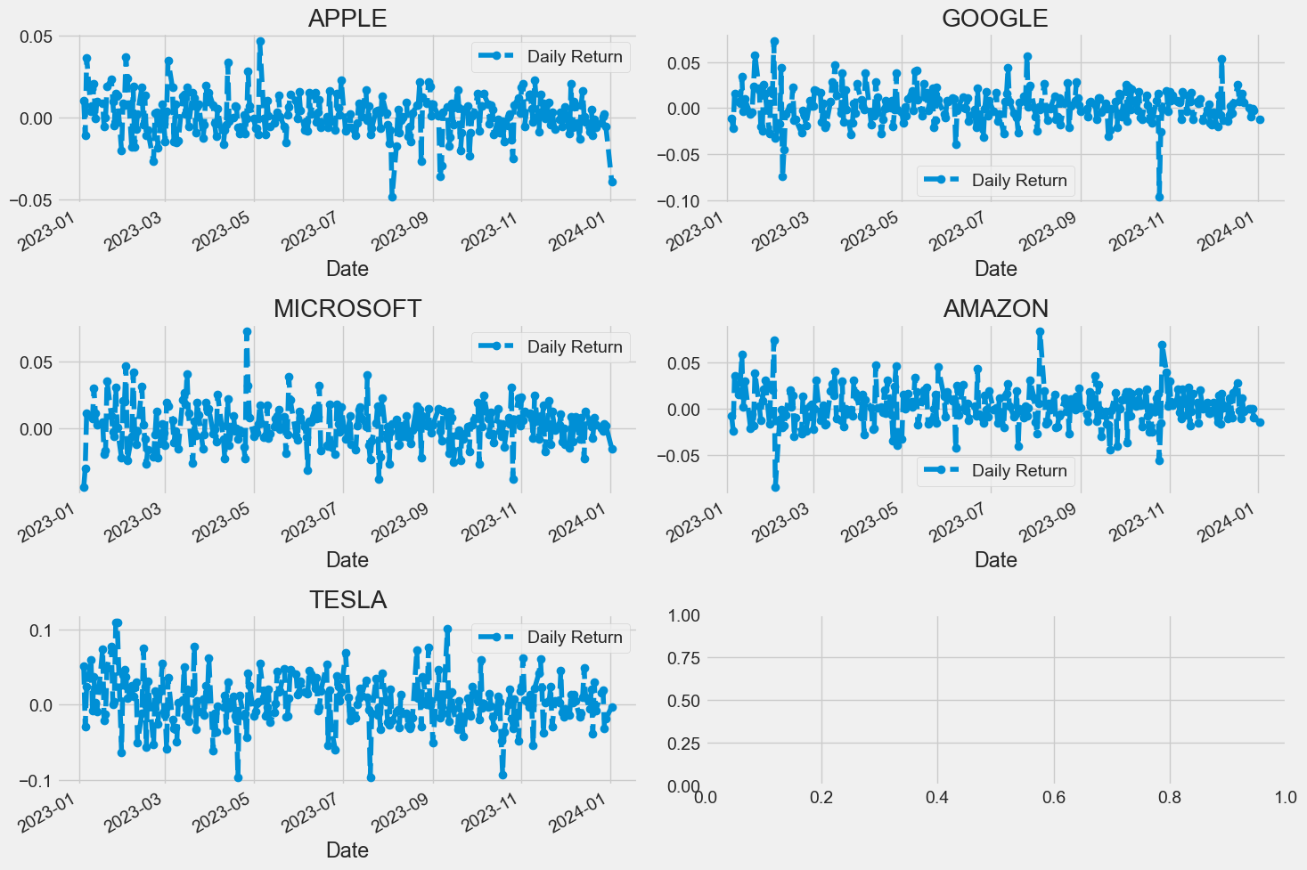
RESULT
Figure 1
9

Slide 10
Conclusion
In conclusion, stock price analysis plays a crucial role in guiding investment decisions and navigating the complexities of financial markets. Through the utilization of sophisticated techniques, such as statistical models, machine learning algorithms, and sentiment analysis, investors can gain valuable insights into the dynamics of stock prices, identify trends, and assess market sentiment.
The journey of stock price analysis begins with data collection, preprocessing, and feature engineering, where historical stock price data is cleansed, transformed, and enriched with relevant features. Subsequently, various analytical methods, such as time series forecasting models like ARIMA, machine learning algorithms, and sentiment analysis techniques, are employed to extract meaningful patterns and relationships from the data.
10

Slide 11
REFERENCES
Python: https://python.org/
Numpy: https://numpy.org/
PyTorch: https://pytorch.org/
Flask: https://flask.palletsprojects.com/en/3.0.x/
Inspiration: https://projectworlds.in/artificial-intelligence-project-handwritten-digits-recognition/
11

